Slide 1
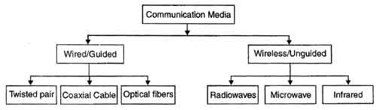
Wireless Communication
Easily generated, Omni-directionally travel long distances, easily penetrate buildings
Used for long distance communication, high SNR, point to point- line of sight
Short range communication, unable to pass through solid objects

Slide 2
Types of wireless communication
Wireless communication
Point to Point communication
Multipoint Communication
Broadcast communication
wireless computer network
wireless computer network
radio service
radio service
cellular
cellular

Slide 3
Wireless Systems: Range
1m 10m 100m 1Km 10Km 100Km 1000Km
Bluetooth
WLAN
Mobile telephony
MW Radio
SW Radio
Satellite Links

Slide 4
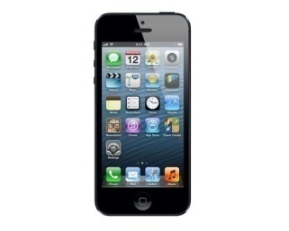
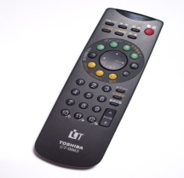
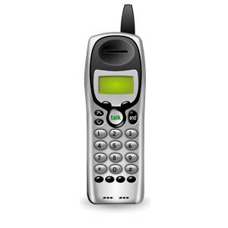
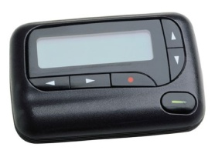
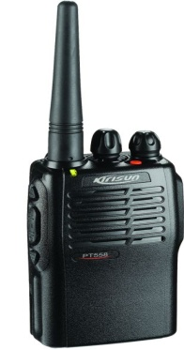
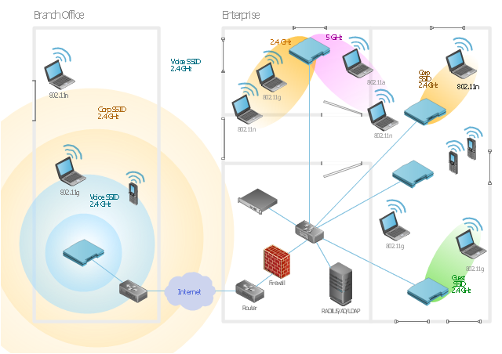
Example of Mobile Radio Systems
Examples
Cordless phone
Remote controller
Hand-held walkie-talkies
Pagers
Cellular telephone
Wireless LAN

Slide 5
Wireless communication systems
Antenna
Information to be transmitted
coding
Modulator
Transmitter
carrier
Antenna
Information Received
Receiver
decoding
DeModulator
carrier

Slide 6
Wireless Communication System Definitions
Base Station: A fixed station in a mobile radio system used for radio communication with mobile stations
Control Channel : Radio channels used for transmission of call setup, call request, call initiation, and other beacon or control purposes.
Subscriber : A user who pays subscription charges for using a mobile communications system.
Transceiver : A device capable of simultaneously transmitting and receiving radio signals.

Slide 7
Wireless Communication System Definitions
Handoff: The process of transferring a mobile station from one channel or base station to another.
Mobile Station : A station in the cellular radio service intended for use while in motion at unspecified locations.
Mobile Switching Center : coordinates the routing of calls in a large Center service area. An MSC is also called a mobile telephone switching office (MTSO).

Slide 8
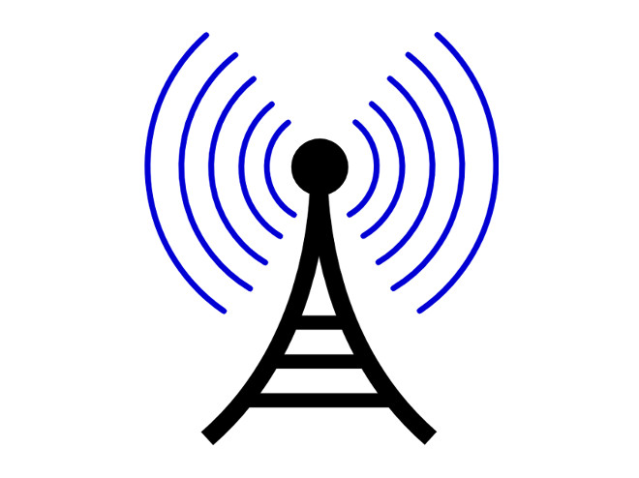
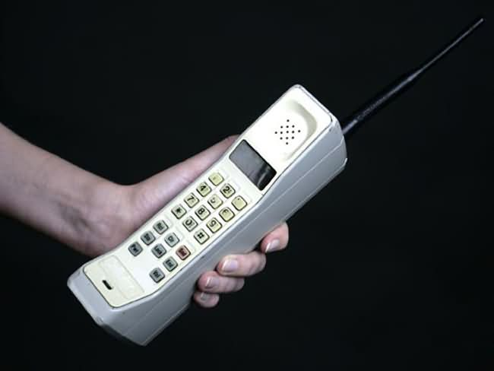
Forward and Reverse Channel
Radio channel used for transmission of information from the base station to the mobile.
Forward Channel
Reverse Channel
Radio channel used for transmission of information from the mobile to base stations

Slide 9
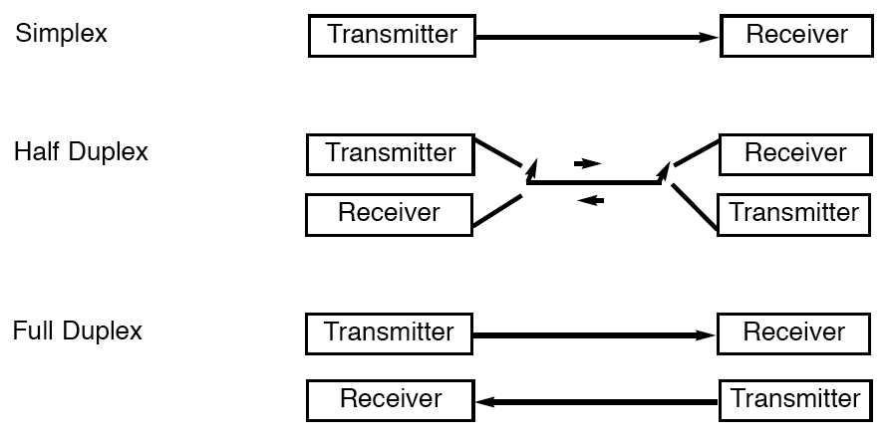
Classification of Mobile Radio Transmission
Classification of mobile radio transmission system

Slide 10
Forms of Full Duplexing
Two forms of Full Duplexing
Frequency division duplexing uses two radio channel
Forward channel: base station to mobile user
Reverse channel: mobile user to base station
Base Station(Tx), Mobile Station(Rx
Frequency(Mhz)
Mobile station (tx), Base station(Rx)
Time (ms)

Slide 11
Forms of Full Duplexing
Time division duplexing shares a single radio channel in time.
Receives for half the frame and transmits for half the frame.
Base Station(Tx), Mobile Station(Rx)
Mobile station (tx), Base station(Rx)
Frequency(Mhz)
Time (ms)

Slide 12
Summary
Point to point communication, multipoint communication, broadcast communication are some of the types of wireless communication.
In wireless communication system, the data is modulated before the transmission and demodulated at the receiver.
In cellular communication, reverse channel is used for communication from mobile to base station and forward channel for communication between the base station to Mobile station.
Simplex, half duplex and full duplex are various ways of mobile radio transmission
Frequency division duplexing and time division duplexing are the forms of full duplex.

